Slide 1
COMPACK – A Network Based RunPE for Software Piracy Prevention
Presented By – Saptarshi Laha (x18170081)

Slide 2
Software Piracy Prevention Methods
Packers (E.g. UPX, Enigma, MPRESS, etc.)
VM-Based Protection (Denuvo, VMProtect, Themida, etc.)

Slide 3
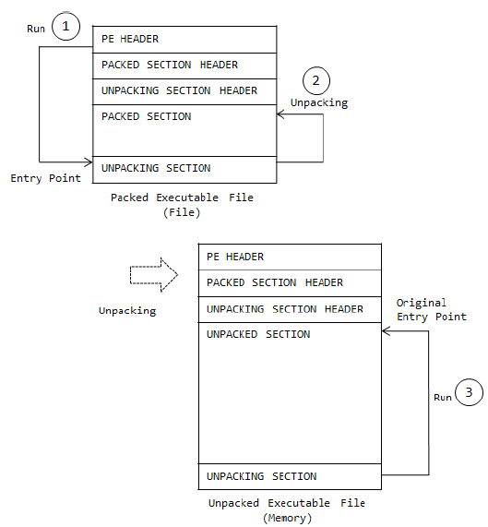
Unpacking Process

Slide 4
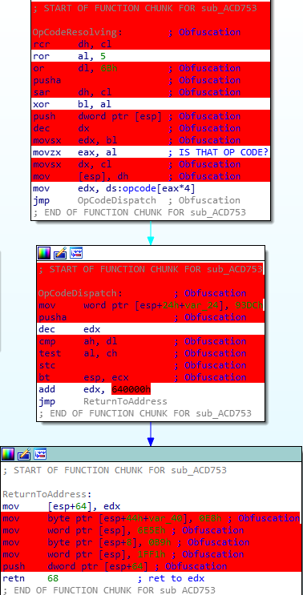
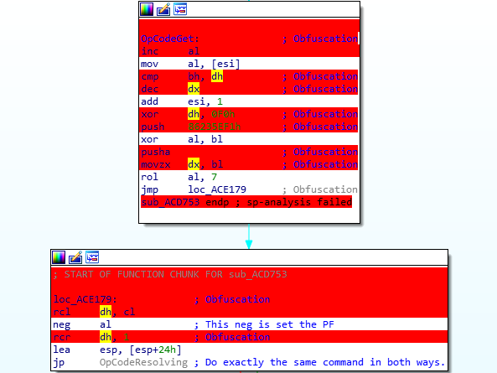
VM-Based Protection

Slide 5
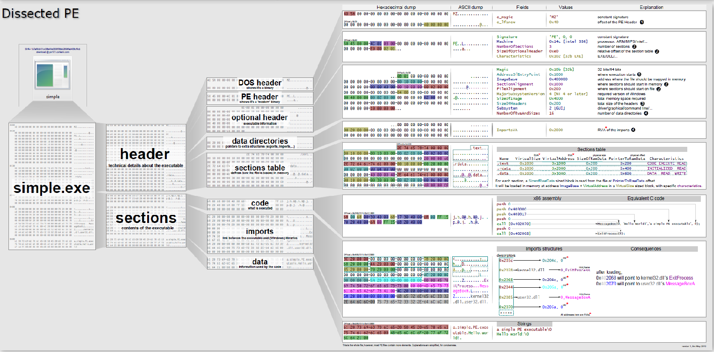
PE File Format

Slide 6
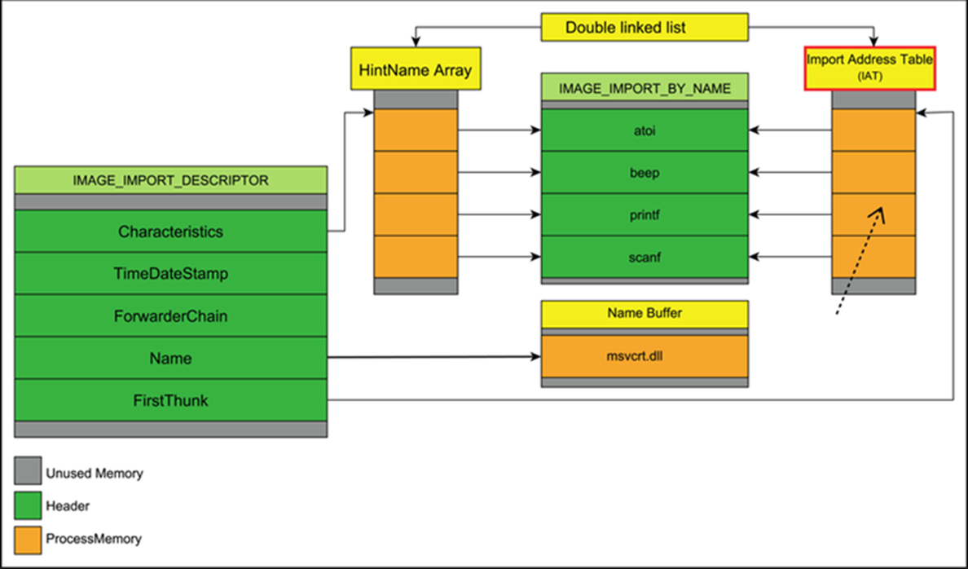
IAT (Import Address Table)

Slide 7
IAT (Import Address Table)

Slide 8
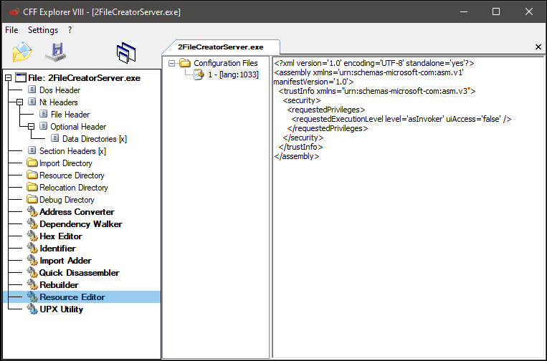
Manifest

Slide 9
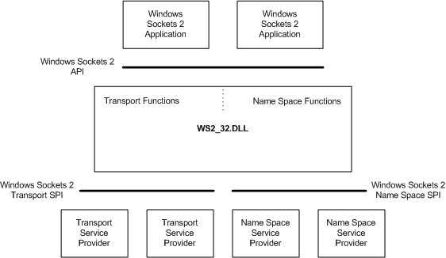
WS2_32.DLL

Slide 10
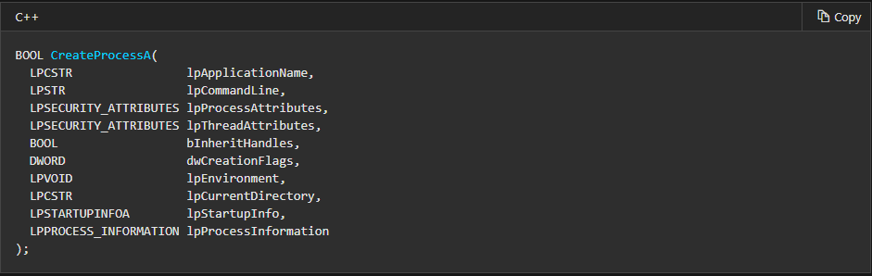
CreateProcess, CREATE_SUSPENDED

Slide 11
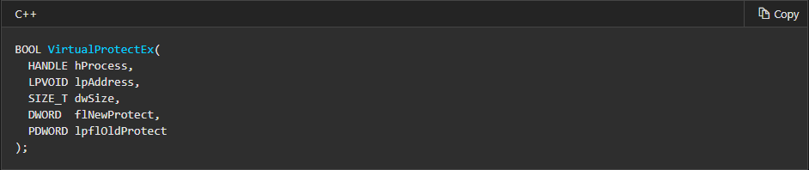
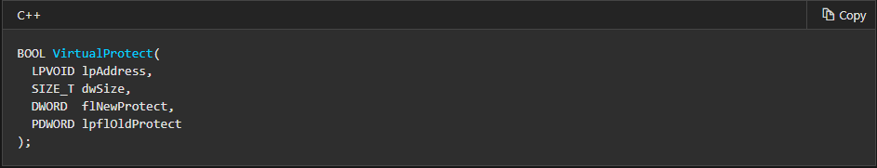
VirtualProtect, VirtualProtectEx

Slide 12
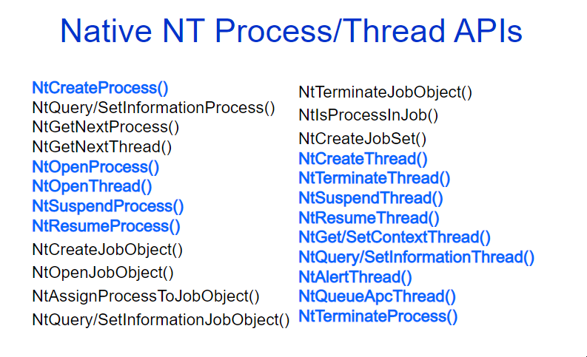
NtResumeProcess, NtSuspendProcess

